Slide 1
Project for Robotics (MCTE 4352)
Student Name: Sabaah Basel Ali
Matric No.: 1626489

Slide 2
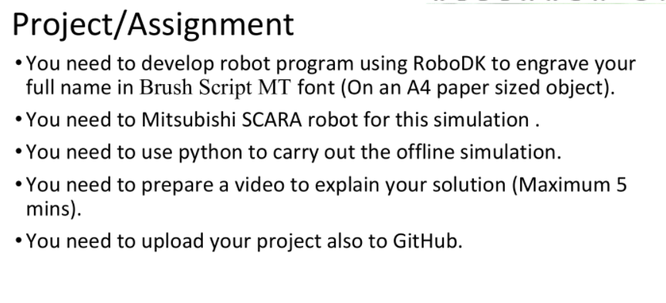
Project Requirements

Slide 3

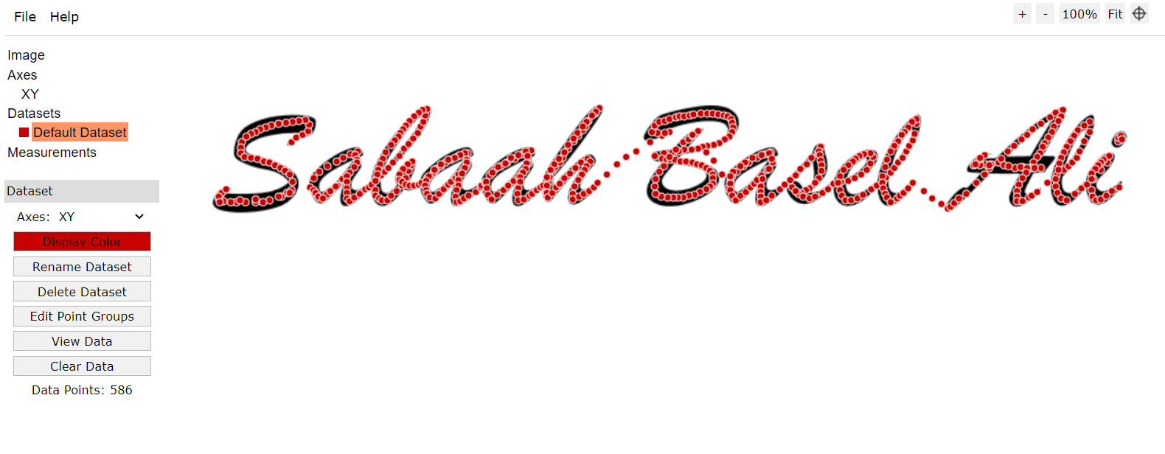

Slide 4
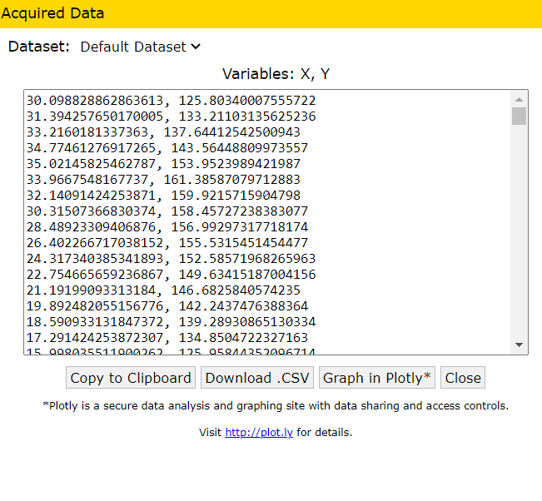

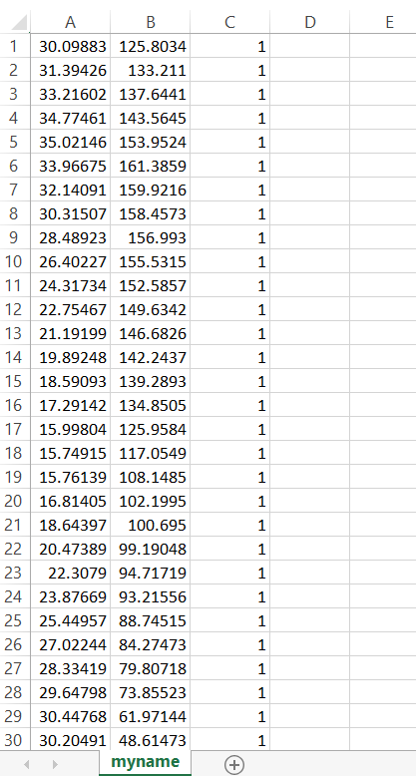

Slide 5
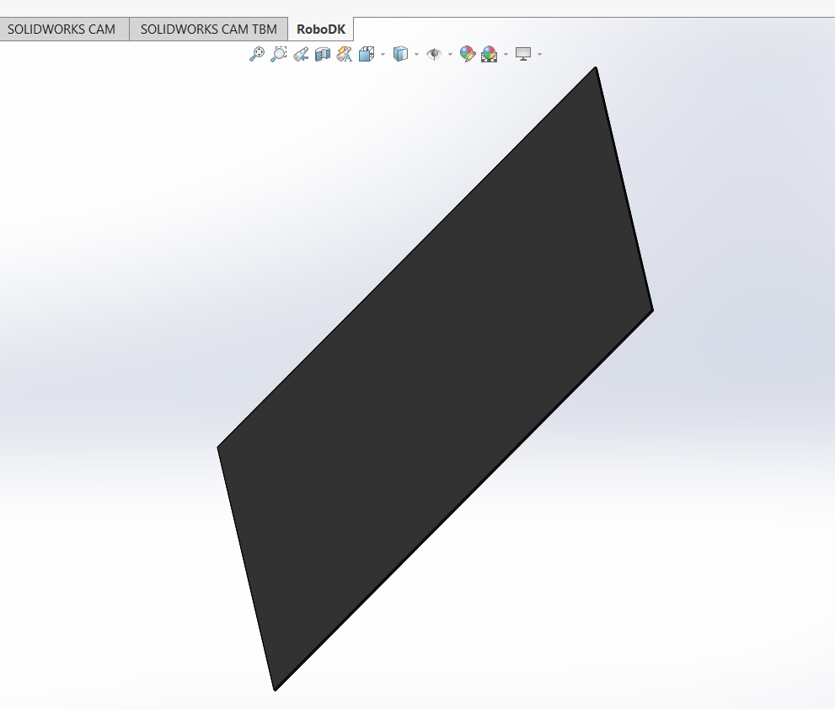


Slide 6
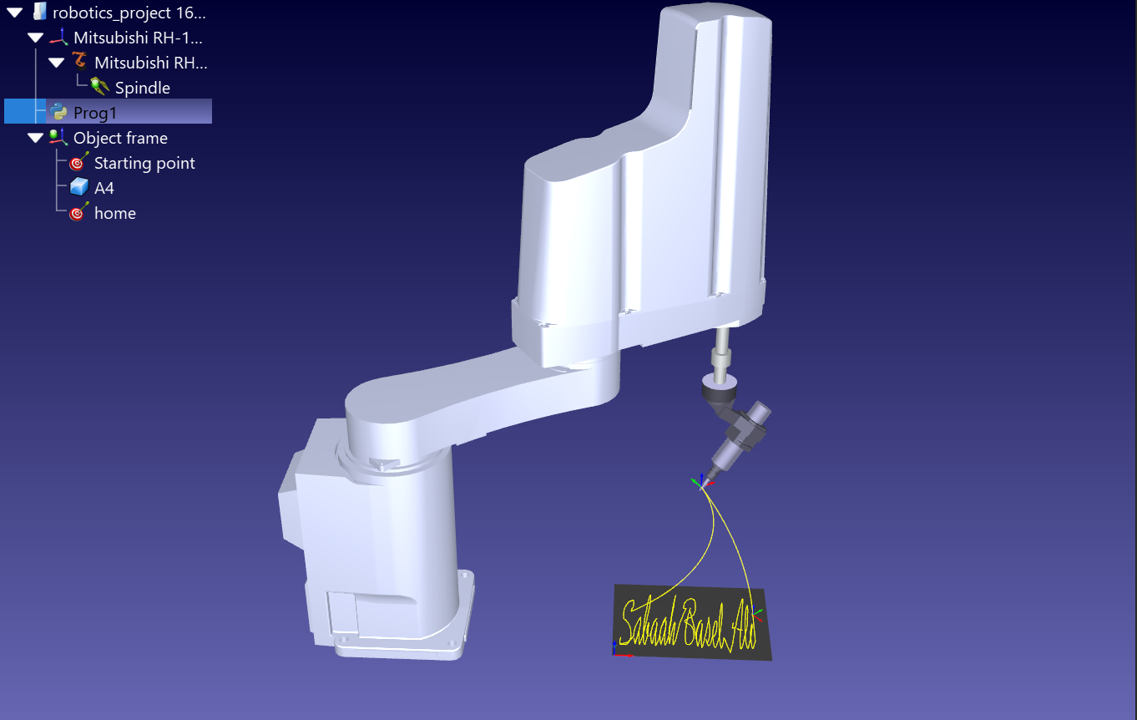

Slide 7
